Slide 1
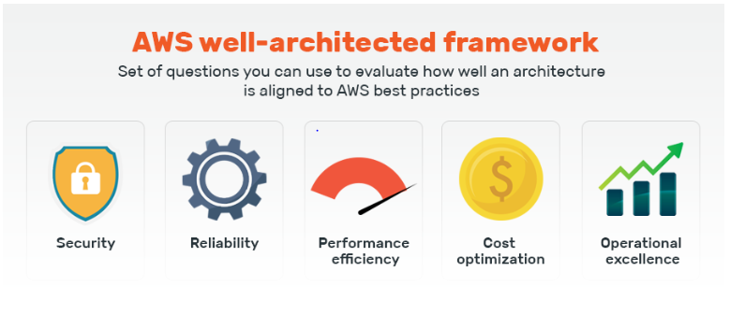
5 Pillars of AWS Architecture

Slide 2
Pillar 1: Security
Identity and access management
Detective controls
Infrastructure protection
Data protection
Prepare for security events
Build a strong identity foundation and define access rules
AWS Services:
IAM
WAF
VPN
NACL
Security Groups
Cloud trail
ACM

Slide 3
Pillar 2: Reliability
Test your recovery procedures in case of interruptions
Increase aggregate system availability
Measure the cost of designing an application with high availability levels
Don’t guess capacity
Maintaining proper DR by selecting as per RPO and RTO.

Slide 4
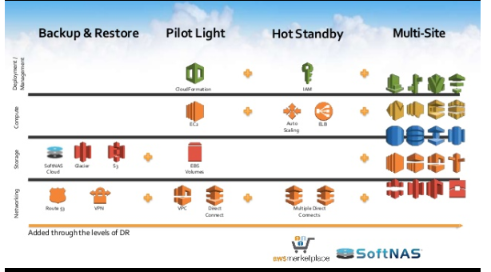
Pillar 2: Reliability

Slide 5
Pillar 3 : Performance efficiency
Experiment often
Have performance metrics in place
Focus on going global as you evolve
Use serverless architectures
ServiceS:
Cloud trail
Fargate
Lambda
Cloud front

Slide 6
Pillar 4: Operation excellence
Perform operations as code
Annotate documentation
Make small changes that are reversible
Refine operations frequently
Anticipate failure
Learn and document outcomes, even failures

Slide 7
Pillar 5 : Cost optimization
Utilizing cost-effective resources
Matching supply with demand
Expenditure awareness
Optimizing over time
This pillar serves as an AWS well-architected framework tool to derive the following design principles:
Work out a consumption model
Measure overall cost efficiency
Don’t waste money and resources on data center operations
Analyze expenditure and allocate to profitable business units
Reduce the cost of ownership

Slide 8
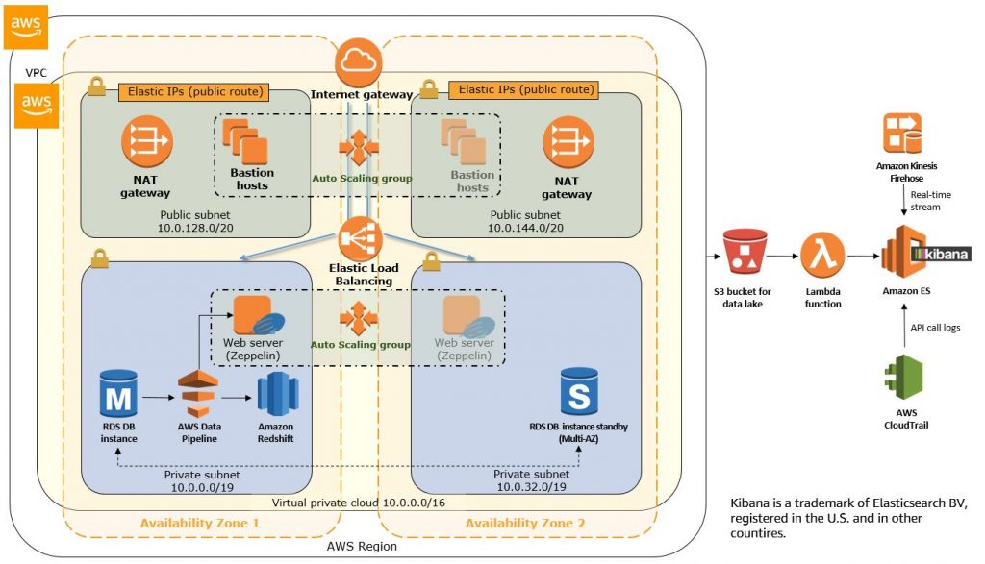

Slide 9
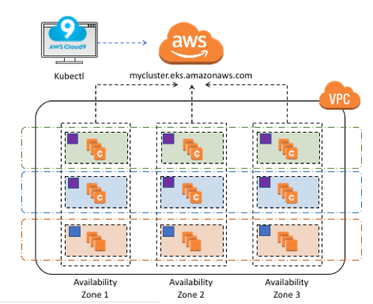
AWS and K8s architecture

Slide 10
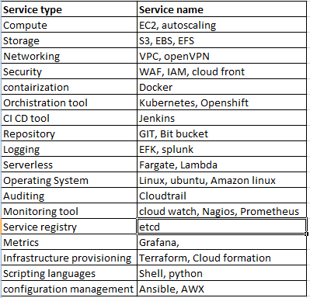

Slide 11
THank YOu

